Slide 1

COMM223 Marketing Management
Lecture 11 – IMC II

Slide 2
Agenda
Public relations
Sales promotion
Personal selling
Direct/Digital marketing

Slide 3
Where are we now …
Company
Company Analysis
Competitor Analysis
Consumer Analysis
Marketing Management
Competitor
Consumer
Product
Promotion
Price
Distribution
Product - Market

Slide 4
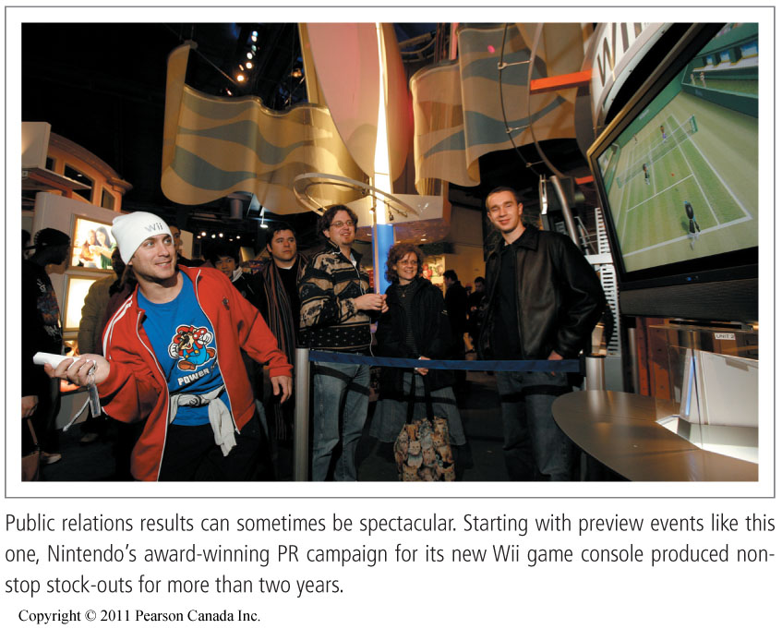
Public Relations
Public Relations:
Building good relations with the company’s various publics by obtaining favorable publicity, building up a good corporate image, and handling or heading off unfavorable rumors, stories, and events.

Slide 5
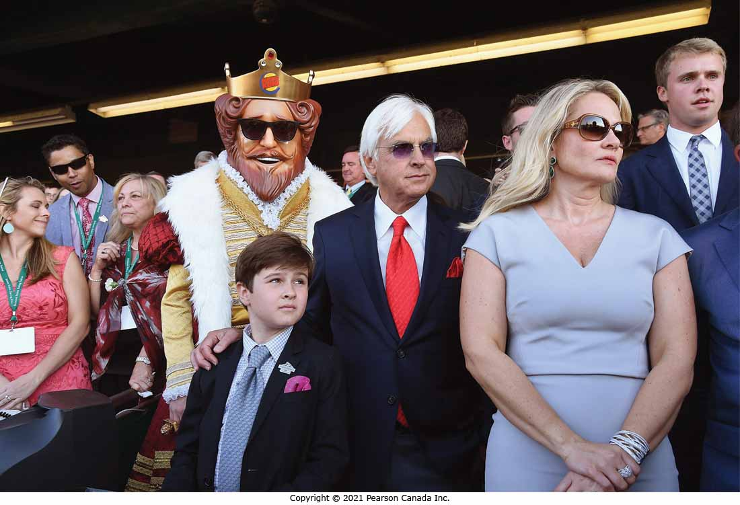
Public Relations Functions
Press Relations
Product and brand Publicity
Public Affairs
Lobbying
Investor Relations
Development

Slide 6
Public Relations
Role and Impact of Public Relations公共关系的作用和影响
Strong impact on public awareness at a lower cost than advertising以比广告更低的成本对公众意识产生强烈影响
Power to engage consumers and make them part of the brand’s story, inject them in daily conversations吸引消费者并使他们成为品牌故事的一部分，将他们注入日常对话的力量
Limited and scattered use有限且分散的使用Powerful brand-building too强大的品牌建设工具l

Slide 7
Major Public Relations Tools
News
Corporate Identity Materials
Special Events
Written Materials
Audiovisual Materials
Public Service Activities

Slide 8
Sales Promotion
Sales Promotion
Short-term incentives to encourage the purchase or sale of a product or a service鼓励购买或销售产品或服务的短期激励措施
Sales promotion targets
Final buyers—Consumer promotions
Retailers and wholesalers—Trade promotions
Business customers—Business promotions
Members of the sales force—Sales force promotions

Slide 9
Sales Promotion
Many factors have contributed to the rapid growth of sales promotion.
Product managers view promotion as an effective short-run sales tool.
Competitors use sales promotion to differentiate their offers.
Advertising efficiency has declined.
Sales promotions help attract today’s more thrift-oriented consumers.以节俭为导向的消费者。

Slide 10
Sales Promotion Objectives
Consumer promotions
To urge short-term customer buying or boost customer-brand engagement
消费者促销
敦促短期客户购买或提高客户品牌参与度Trade promotions
To get retailers to carry new items and more inventory, buy ahead, or promote the company’s products and give them more shelf space贸易促销
为了让零售商携带新商品和更多库存，提前购买或推广公司的产品并给他们更多的货架空间
商业促销
产生业务线索、刺激购买、奖励客户和激励销售人员
Business promotions
To generate business leads, stimulate purchases, reward customers, and motivate salespeople

Slide 11
Consumer Promotion Tools
Tools | Description
Samples | Offers of a trial amount of a product Most effective and expensive
Coupons | Certificates that save buyers money when they purchase specified products
Rebates (cash refunds) | Price reduction occurs after the purchase Customer sends proof of purchase to the manufacturer, which then refunds part of the purchase price by mail
Price packs (cents-off deals) | Offers consumers savings off the regular price of a product
Premiums | Goods offered either free or at low cost as an incentive to buy a product

Slide 12
Consumer Promotion Tools
Tools | Description
Advertising specialties | Useful articles imprinted with an advertiser’s name, logo, or message that are given as gifts to consumers
Point-of-purchase (POP) promotions | Displays and demonstrations that take place at the point of sale
Contests, sweepstakes, and games | Give consumers the chance to win something
Event marketing (or event sponsorships) | Creating a brand-marketing event or serving as a sole or participating sponsor of events created by others

Slide 13
Major Sales Promotion Tools
Trade Promotion Tools
Used to persuade resellers to carry a brand, give it shelf space, and promote it in ads
Trade promotion tools:
Contests, premiums, and displays
Discounts and allowances
Free goods
Push money
Specialty advertising items

Slide 14
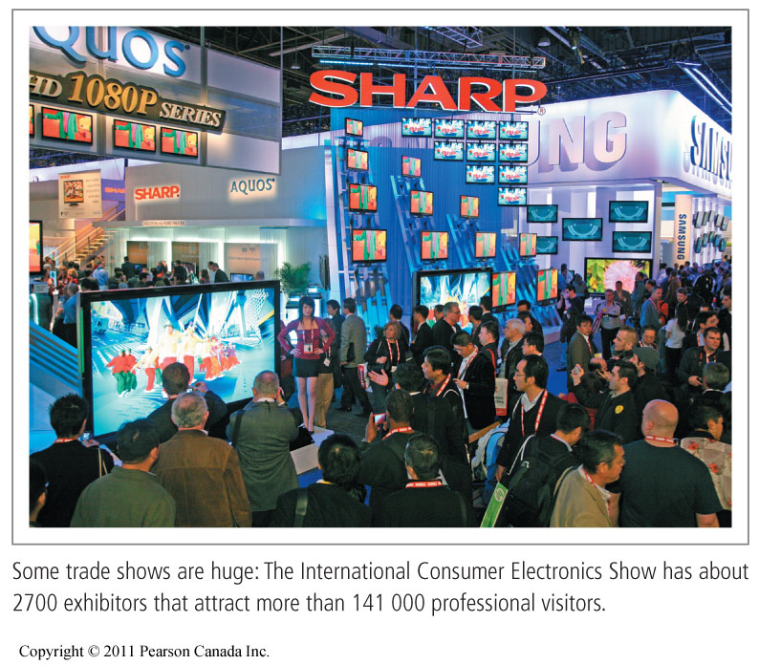
Major Sales Promotion Tools
Business Promotion Tools
Used to generate business leads, stimulate purchases, reward customers, and motivate salespeople
Business promotion tools:
Conventions and trade shows
Sales contests

Slide 15
Sales Promotion
Key Decisions When Developing the Sales Promotion Program:
Size of the incentive
Conditions for participation
Promotion and distribution of the actual sales promotion program
Length of the promotional program
Evaluation

Slide 16
Personal Selling
Personal presentations by a sales force to engage customers, make sales, and build customer relationships
销售人员进行个人演示，以吸引客户、进行销售和建立客户关系
Salesperson: Represents a company to customers by performing the following activities:
Prospecting and communicating
Selling and servicing
Gathering information and building relationships
销售人员：通过执行以下活动向客户代表公司：
勘探与交流
销售和服务
收集信息和建立关系

Slide 17

The Role of the Sales Force
Links the company with its customers
Coordinates marketing and sales

Slide 18
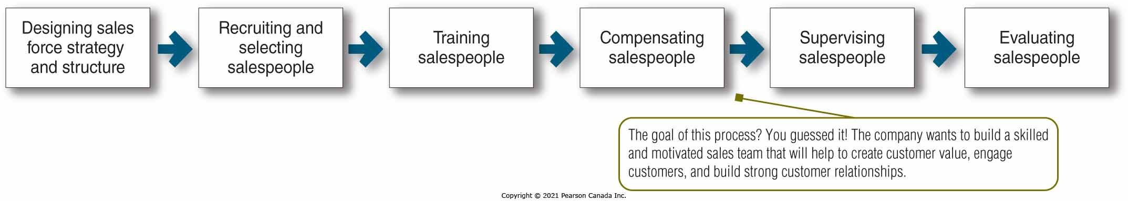
Sales Force Management
Sales force management—analyzing, planning, implementing, and controlling sales force activities
Major Steps in Sales Force Management

Slide 19
Designing the Sales Force Strategy and Structure
Types of sales force structures:
Territorial
Product
Customer (or market)
Salespeople can be specialized by
Customer and territory客户和地区
Product and territory产品和地域
Product and customer产品和客户
Territory, product, and customer区域、产品和客户

Slide 20
Sales Force Size
May range from only a few to thousands
Companies may use the workload approach to set sales force size.公司可以使用工作量方法来设置销售人员规模。
Accounts grouped into classes based on size, status, or the amount of effort required to maintain the account
Number of salespeople needed to call on each class of accounts is then determined
根据规模、状态或维护帐户所需的工作量将帐户分组
然后确定需要拜访每类客户的销售人员数量

Slide 21
Other Sales Force Strategy and Structure Issues
Outside sales force (field sales force)
Travels to call on customers in the field
Inside sales force
Conducts business from their offices via telephone, the Internet, or visits from prospective buyers
Technical sales support people
Sales assistants
Telemarketers and online sellers
Team selling
Teams of people from different departments used to service large, complex accounts

Slide 22
Recruiting and Selecting Salespeople
A company should analyze the sales job and the characteristics of its most successful salespeople.
Sources for the recruitment of salespeople:
Referrals from current salespeople
Employment agencies
Internet and online social media
Posting ads and notices
College placement services
Salespeople at other companies

Slide 23
Training Salespeople
Goals of training are to teach salespeople
About different types of customers
How to sell effectively
About the company’s objectives, organization, products, and the strategies of competitors
Online training builds sales skills using videos, Internet-based exercises, or simulations.
Virtual instructor-led training (VILT)

Slide 24
Compensating Salespeople
Elements of compensation
Fixed amount—salary
Variable amount—commissions or bonuses
补偿要素
固定金额——工资
可变金额——佣金或奖金

Slide 25
Supervising Salespeople
Help salespeople work smart by doing the right things in the right ways
Tools of supervision:
Call plan
Time-and-duty analysis
Sales force automation system
监督工具：
通话计划
时间和任务分析
销售人员自动化系统

Slide 26
Motivating Salespeople
Encourage salespeople to work hard and energetically toward sales force goals
Management can boost sales force morale and performance through its
Organizational climate
Sales quotas
Positive incentives
鼓励销售人员为销售人员的目标努力而积极地工作
管理层可以通过其提高销售人员的士气和绩效
组织氛围
销售配额
积极的激励

Slide 27
Evaluating Salespeople and Sales Force Performance
Management gets information about its salespeople
From sales, call, and expense reports
By monitoring the sales and profit performance data in the salesperson’s territory
Through personal observation, customer surveys, and talks with other salespeople
Formal evaluations force management to develop standards for judging performance.
管理层获取有关其销售人员的信息
来自销售、电话和费用报告
通过监控销售人员所在区域的销售和利润表现数据
通过个人观察、客户调查以及与其他销售人员的交谈
正式的评估迫使管理层制定绩效评判标准。

Slide 28
Social Selling: Online, Mobile, and Social Media Tools
Provide salespeople with powerful tools for
Identifying and learning about prospects
Engaging customers
Creating customer value
Closing sales
Nurturing customer relationships
Help sales forces to be more efficient, cost-effective, and productive
为销售人员提供强大的工具
识别和了解潜在客户
吸引客户
创造客户价值
结束销售
培养客户关系
帮助销售人员提高效率、成本效益和生产力

Slide 29
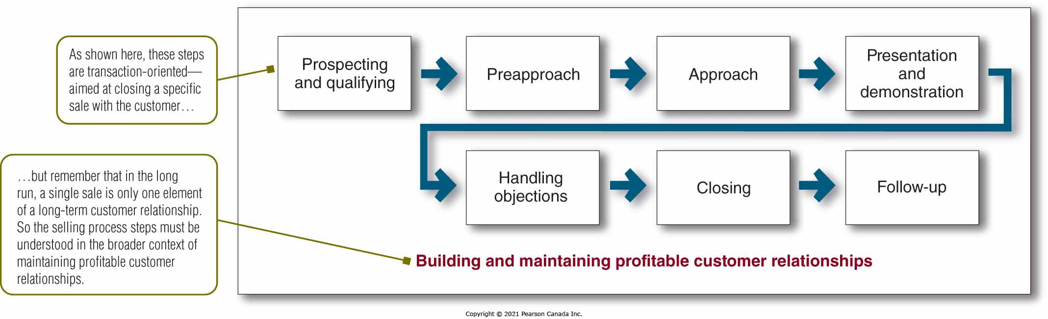
The Personal Selling Process

Slide 30
Direct and Digital Marketing
Engage directly with targeted individual consumers and customer communities to
obtain an immediate response
Build lasting customer relationships, engagement, brand community, and sales
直接与目标个人消费者和客户社区互动，以
立即得到回应
建立持久的客户关系、参与度、品牌社区和销售

Slide 31
Rapid Growth of Direct and Digital Marketing
Fastest-growing form of marketing
Direct marketing becoming more Internet-based
Direct marketing claims a surging share of marketing spending and sales
Includes online display and search advertising, video, social media, mobile, email
增长最快的营销形式
直销越来越基于互联网
直销在营销支出和销售中所占份额飙升
包括在线展示和搜索广告、视频、社交媒体、移动设备、电子邮件

Slide 32
Benefits of Direct and Digital Marketing to Buyers
Buyers
Convenient, easy, and private
Easy buyer-seller interaction
Quick access to products and relevant information
Brand engagement and community
Sellers
Low-cost, efficient, and speedy
Build close, personalized, interactive, one-to-one customer relationships
Greater flexibility
买家
方便、轻松、私密
轻松的买卖双方互动
快速访问产品和相关信息
品牌参与和社区
卖家
低成本、高效、快速
建立密切、个性化、互动、一对一的客户关系
更大的灵活性

Slide 33
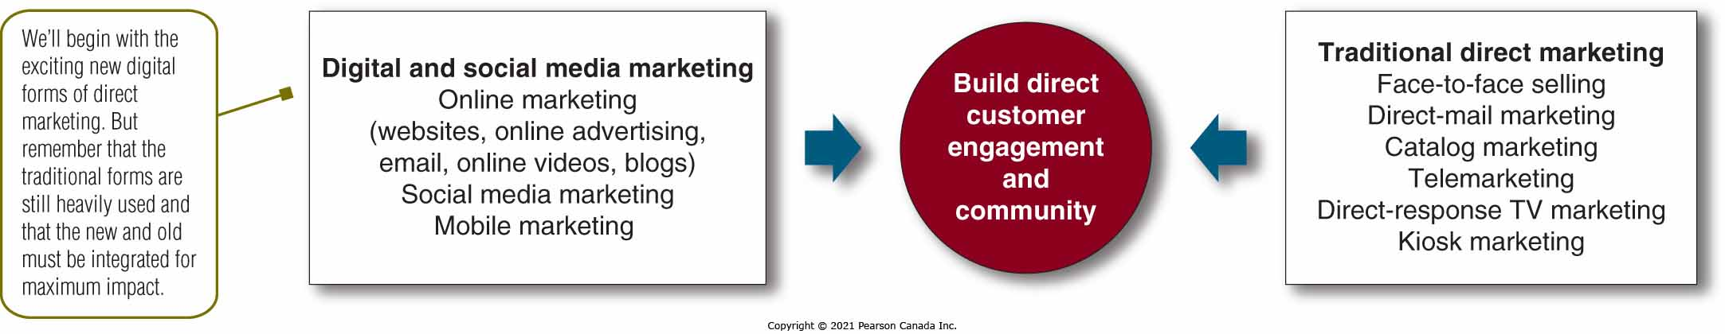
Forms of Direct and Digital Marketing

Slide 34
Marketing, the Internet, and the Digital Age
Digital and social media marketing: Using digital marketing tools to engage consumers anywhere, anytime via their digital devices
Digital age: Changing customers’ notions of convenience, speed, price, product information, service, and brand interactions
Omni-channel retailing: Creating a seamless cross-channel buying experience that integrates in-store, online, and mobile shopping
数字和社交媒体营销：使用数字营销工具随时随地通过数字设备吸引消费者
数字时代：改变客户对便利、速度、价格、产品信息、服务和品牌互动的观念
全渠道零售：打造无缝的跨渠道购买体验，整合店内、在线和移动购物

Slide 35
Online Marketing
Marketing via the Internet using company Web sites, online ads and promotions, email, online video, and blogs
Marketing Web sites: Engage consumers to move them closer to a direct purchase or other marketing outcome
Branded community Web sites: Present brand content that engages consumers and creates customer-brand community
使用公司网站、在线广告和促销、电子邮件、在线视频和博客通过 Internet 进行营销
营销网站：吸引消费者，使他们更接近直接购买或其他营销结果
品牌社区网站：展示吸引消费者并创建客户品牌社区的品牌内容

Slide 36
Online Advertising and Email Marketing
Online advertising: Appears while consumers are browsing online
Email marketing: Sending highly targeted, highly personalized, relationship-building marketing messages via email
Spam: Unsolicited, unwanted commercial email messages
在线广告：在消费者在线浏览时出现
电子邮件营销：通过电子邮件发送高度针对性、高度个性化、建立关系的营销信息
垃圾邮件：未经请求的、不需要的商业电子邮件

Slide 37
Online Videos
Posting digital video content on brand Web sites or social media
Viral marketing: Videos, ads, and other marketing content that customers seek out or pass along to friends
在品牌网站或社交媒体上发布数字视频内容
病毒式营销：客户寻找或传递给朋友的视频、广告和其他营销内容

Slide 38
Blogs and Other Online Forums
Online journals of narrowly defined topics where people and companies post their thoughts and other content
Benefits: A fresh, original, personal, and inexpensive way to enter into consumer online conversations
Limitations: Cluttered, difficult to control and largely a consumer-controlled medium
狭义主题的在线期刊，人们和公司在其中发表他们的想法和其他内容
好处：一种新颖、新颖、个性化且廉价的方式进入消费者在线对话
局限性：杂乱无章，难以控制，主要是消费者控制的媒体

Slide 39
Social Media Marketing
Social media: Independent and commercial online communities where people congregate, to socialize and share messages, opinions, pictures, videos, and other content
Marketers engage social media in two ways:
Using the existing ones
Setting up their own

Slide 40
Social Media Marketing Advantages and Challenges
Challenges
Effective usage uncertain
Difficult to measure results
Largely user controlled
挑战
有效使用不确定
难以衡量结果
主要由用户控制
Advantages
Targeted and personal
Interactive
Immediate and timely
Cost effective
Engagement and social sharing capabilities
好处
有针对性和个性化
交互的
即时和及时
成本效益
参与和社交分享能力

Slide 41
Integrated Social Media Marketing
Large companies design social media efforts that blend with and support other elements of a brand’s marketing strategy and tactics.
Firms that use social media effectively create brand-related social sharing, engagement, and customer community.
大公司设计的社交媒体努力融合并支持品牌营销战略和策略的其他元素。
使用社交媒体的公司有效地创建了与品牌相关的社交分享、参与和客户社区。

Slide 42
Mobile Marketing
Promotional content delivered to consumers through their mobile devices
Engages customers anywhere, anytime during the buying and relationship-building processes
通过移动设备向消费者发送的促销内容
在购买和建立关系的过程中随时随地与客户互动

Slide 43
Direct-Mail Marketing
Sending an offer, announcement, reminder, or other item directly to a person at a particular address
Tangible and creates emotional connection with customers
Effective component of a broader integrated marketing campaign
Direct and personalized
Sent to consumers who want to receive it
直接向特定地址的人发送报价、公告、提醒或其他项目
有形并与客户建立情感联系
更广泛的整合营销活动的有效组成部分
直接和个性化
发送给想要接收的消费者

Slide 44
Catalogue Marketing
Print, video, or digital catalogues that are mailed to select customers, made available in stores, or presented online
Eliminates printing and mailing costs
No space constraints
Broader assortment of presentation formats
Real-time merchandising capabilities
Prices can be adjusted instantly
邮寄给选定客户、在商店提供或在线展示的印刷、视频或数字目录
消除打印和邮寄成本
没有空间限制
更广泛的演示格式
实时销售能力
价格可以即时调整

Slide 45
Telemarketing and Direct-Response Television (DRTV) Marketing
Telemarketing: Selling directly to customers using the telephone
Outbound and inbound telephone marketing
Rise of do-not-call legislation resulted in opt-in calling systems
Direct-response television (DRTV) marketing
Direct-response television advertising
Interactive TV (iTV) advertising
电话营销：使用电话直接向客户销售
呼出和呼入电话营销
禁止呼叫立法的兴起导致选择加入呼叫系统
直接响应电视 (DRTV) 营销
直接反应的电视广告
互动电视 (iTV) 广告

Slide 46
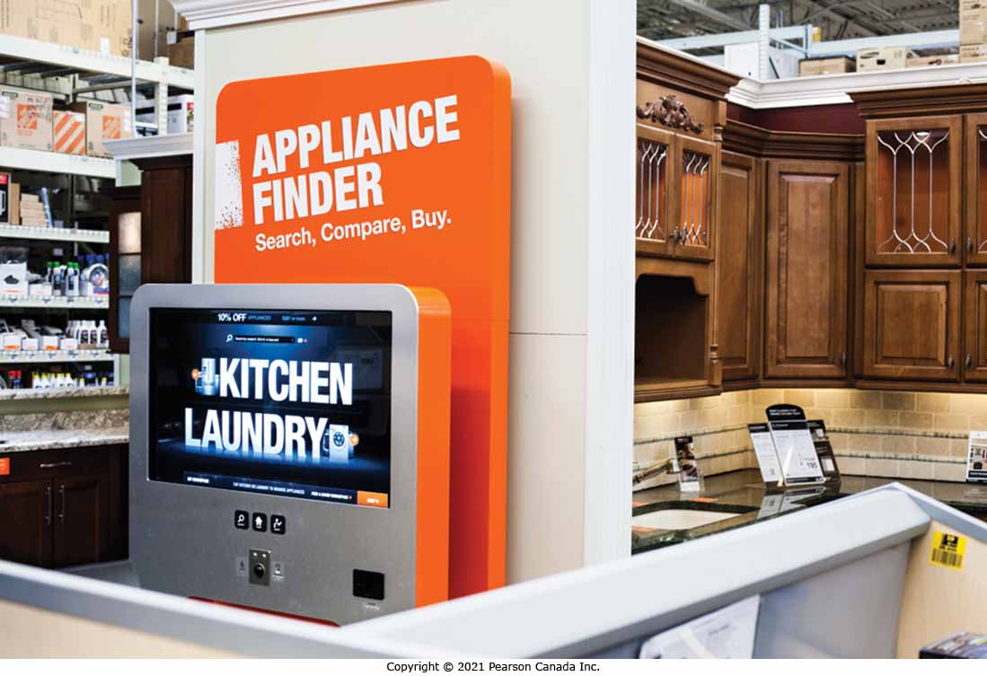
Kiosk Marketing
Product or service information and ordering machines placed by companies
Smart kiosks
Wireless-enabled
Facial recognition
公司放置的产品或服务信息和订购机器
智能信息亭
无线启用
面部识别

Slide 47
Public Policy Issues in Direct and Digital Marketing
Irritation, Unfairness, Deception, and Fraud
Consumer Privacy
A Need for Action
刺激、不公平、欺骗和欺诈
消费者隐私
需要采取行动

Slide 48
Irritation, Unfairness, Deception, and Fraud
Irritation
Loud, long, and insistent TV commercials
Junk mail and spam
Unfairness
Taking unfair advantage of impulsive buyers
Deception and fraud
Investment scams or phony collections for charity
Internet fraud
Phishing
Online and digital security
Access by vulnerable or unauthorized groups
刺激
响亮、冗长、持续不断的电视广告
垃圾邮件和垃圾邮件
不公平
不公平地利用冲动的买家
欺骗和欺诈
投资诈骗或慈善募捐
网络诈骗
网络钓鱼
在线和数字安全
易受攻击或未经授权的团体访问

Slide 49
Consumer Privacy
Fear of invasion of privacy
Ready availability of information leaves consumers open to abuse
害怕侵犯隐私
随时可用的信息使消费者容易受到滥用

Slide 50

A Need for Action
Government actions
Do-not-call, do-not-mail, do-not-track lists
Legislation—Give more control to consumers over how online information is used
Marketers’ actions
Self-regulatory principles
Advertising option icon
Privacy rights of children
Companies’ actions
Own security measures
Industry-wide measures
政府行为
请勿致电、请勿邮寄、请勿追踪列表
立法——让消费者更好地控制在线信息的使用方式
营销人员的行动
自律原则
广告选项图标
儿童的隐私权
公司的行动
自己的安全措施
全行业措施

Slide 51
Integrated Marketing Communication
Coordinate across different promotion mix elements to achieve the promotion objectives
Factors affecting the promotion mix:
Objectives (e.g., Target Audience, Pull vs. Push)
Unique nature of individual promotion mix elements
Nature of the product
Stages in the Product Life Cycle
Stages in the Consumer Problem Solving Process
Promotion Budget
协调不同的促销组合元素以实现促销目标
影响促销组合的因素：
目标（例如，目标受众、拉与推）
个人促销组合元素的独特性
产品性质
产品生命周期的阶段
消费者问题解决过程的阶段
促销预算

Slide 52
Read Chapter 15 & 16

